Slide 2
CHAPTER 6
Discounted Cash Flows and Valuation

Slide 3
Level Cash Flows: Annuities and Perpetuities
Quick Links
Multiple Cash Flows
Cash Flows That Grow at a Constant Rate
The Effective Annual Interest Rate
Exhibits

Slide 4
Future Value of Multiple Cash Flows
Multiple Cash Flows
Solving future value problems with multiple cash flows:
1. Draw timeline to ascertain each cash flow is placed in correct time period
2. Calculate future value of each cash flow for its time period
3. Add up the future values
Go to Exhibit 6.1 & 6.2

Slide 5
Multiple Cash Flows
Present Value of Multiple Cash Flows
Many business situations call for computing present value of a series of expected future cash flows
  determining market value of security
  deciding whether to make capital investment
Process similar to determining future value of multiple cash flows
Go to Exhibit 6.3

Slide 6
Multiple Cash Flows
Present Value of Multiple Cash Flows
First, prepare timeline to identify magnitude and timing of cash flows
  Next, calculate present value of each cash flow using equation 5.4 from the previous chapter.
  Finally, add up all present values.
  Sum of present values of stream of future cash flows is their current market price, or value

Slide 7
Annuities and Perpetuities
Level Cash Flows
Many situations exist where businesses and individuals would face either receiving or paying constant amount for length of period
Annuity – stream of cash flows when firm faces stream of constant payments on a bank loan for a period of time
Individual investors may make constant payments on home or car loans, or invest fixed amount year after year saving for retirement

Slide 8
Level Cash Flows
Annuities and Perpetuities
Annuity: any financial contract calling for equally spaced level cash flows over finite number of periods
Perpetuity: contract calling for cash flow payments to continue forever
Ordinary annuities: constant cash flows occurring at end of each period

Slide 9
Level Cash Flows
Present Value of an Annuity
Can calculate present value of annuity same way present value of multiple cash flows is calculated
  becomes tedious with large # of payments
Instead, simplify equation 5.4 to obtain annuity factor
  results in equation 6.1 that can be used to calculate the annuity’s present value
Go to Exhibit 6.4

Slide 10
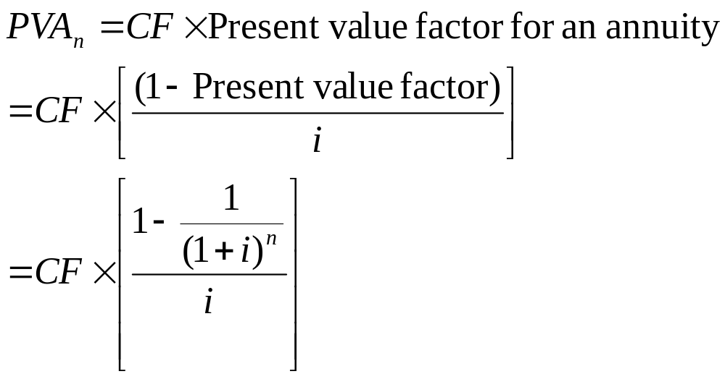
Level Cash Flows
Equation 6.1

Slide 11
Level Cash Flows
Present Value of an Annuity
Financial calculators and spreadsheets may be used in addition to equation. Present value and annuity tables created with help of equation 6.1 have limited use outside of classroom setting.
One problem widely solved using financial calculator is finding monthly payment on car or home loan

Slide 12
Level Cash Flows
Preparing a Loan Amortization Schedule
Amortization: the way the borrowed amount (principal) is paid down over life of loan
Monthly loan payment is structured so each month portion of principal is paid off; at time loan matures, it is entirely paid off

Slide 13
Level Cash Flows
Preparing a Loan Amortization Schedule
Amortized loan: each loan payment contains some payment of principal and an interest payment
Loan amortization schedule is a table showing:
  loan balance at beginning and end of each period
  payment made during that period
  how much of payment represents interest
  how much represents repayment of principal

Slide 14
Level Cash Flows
Preparing a Loan Amortization Schedule
With amortized loan, larger proportion of each month’s payment goes towards interest in early periods
  as loan is paid down, greater proportion of each payment is used to pay down principal
Amortization schedules are best done on a spreadsheet

Slide 15
Finding the Interest Rate
Level Cash Flows
The annuity equation can also be used to find interest rate or discount rate for an annuity.
To determine rate of return for the annuity, we need to solve equation for the unknown value i.
Other than using trial and error approach, easier to solve using financial calculator

Slide 16
Level Cash Flows
Future Value of an Annuity
Future value annuity calculations usually involve finding what a savings or investment activity is worth at some future point
  E.g. saving periodically for vacation, car, house, or retirement
We can derive the future value annuity equation from the present value annuity equation (equation 6.1). This results in equation 6.2.

Slide 17
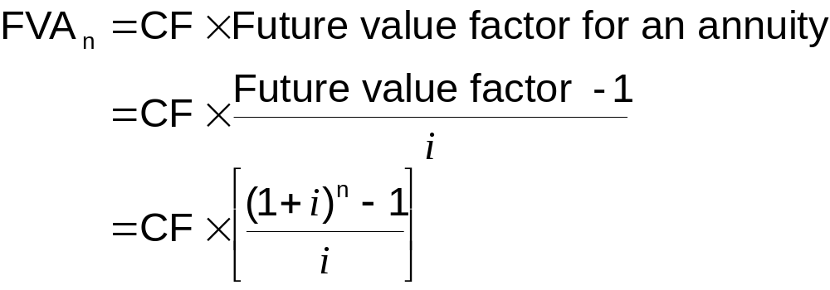
Level Cash Flows
Equation 6.2

Slide 18
Level Cash Flows
Future Value of an Annuity
As with present value annuity calculations, future value calculations are easier when financial calculators or spreadsheets are used – esp. when lengthy investment periods are involved.

Slide 19
Perpetuities
Level Cash Flows
A perpetuity is constant stream of cash flows that goes on for infinite period
In stock markets, preferred stock issues are considered to be perpetuities, with issuer paying a constant dividend to holders
Equation for present value of a perpetuity can be derived from present value of an annuity equation with n tending to infinity

Slide 20
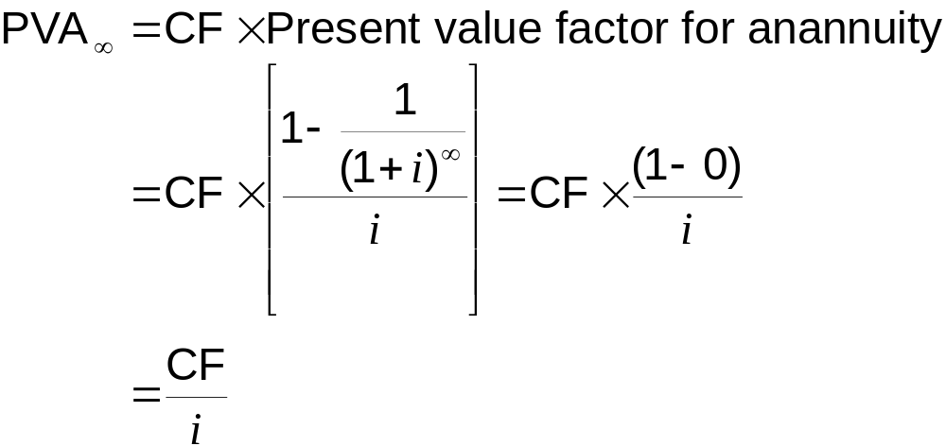
Level Cash Flows
Perpetuities

Slide 21
Level Cash Flows
Perpetuities
Important relationship between present value of annuity and a perpetuity:
  Just as perpetuity equation was derived from present value annuity equation, one can also derive present value of an annuity from the equation for a perpetuity

Slide 22
Level Cash Flows
Annuity Due
Annuity is called an annuity due when there is an annuity with payment being incurred at beginning of each period rather than at end
Rent or lease payments typically made at beginning of each period rather than at end
Go to Exhibit 6.7

Slide 23
Level Cash Flows
Annuity Due
Annuity transformation method (equation 6.4) shows relationship between ordinary annuity and annuity due
Each period’s cash flow thus earns extra period of interest compared to ordinary annuity
  present or future value of annuity due is always higher than that of ordinary annuity
Annuity due = Ordinary annuity value × (1+i)

Slide 24
Cash Flows That Grow at a Constant Rate
In addition to constant cash flow streams, one may have to deal with cash flows that grow at constant rate over time
These cash-flow streams called growing annuities or growing perpetuities

Slide 25
Growing Annuity
Cash Flows That Grow at a Constant Rate
Business may need to compute value of multiyear product or service contracts with cash flows that increase each year at constant rate
These are called growing annuities.
Example of growing annuity: valuation of growing business whose cash flows increase every year at constant rate

Slide 26
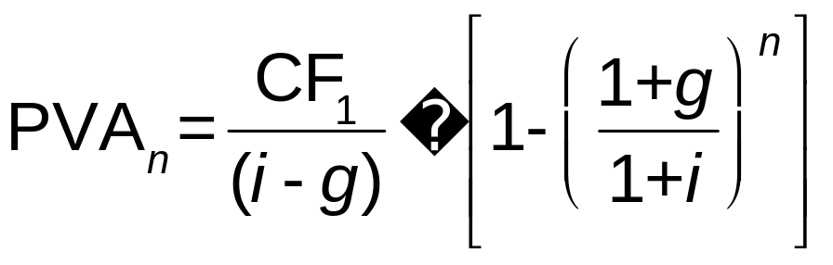
Growing Annuity
Cash Flows That Grow at a Constant Rate
Use this equation to value the present value of growing annuity (equation 6.5) when the growth rate is less than discount rate

Slide 27
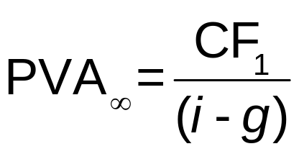
Growing Perpetuity
Cash Flows That Grow at a Constant Rate
When cash flow stream features constant growing annuity forever
Can be derived from equation 6.5 when n tends to infinity and results in equation 6.6

Slide 28
Effective Annual Interest Rate
Interest rates can be quoted in financial markets in variety of ways
Most common quote, especially for a loan, is annual percentage rate (APR)
APR represents simple interest accrued on loan or investment in a single period; annualized over a year by multiplying it by appropriate number of periods in a year

Slide 29
Calculating the Effective Annual Rate (EAR)
Effective Annual Interest Rate
Correct way to compute annualized rate is to reflect compounding that occurs; involves calculating effective annual rate (EAR)
Effective annual interest rate (EAR) defined as annual growth rate that takes compounding into account

Slide 30
Calculating the Effective Annual Rate (EAR)
Effective Annual Interest Rate
EAR = (1 + Quoted rate/m)^{m} – 1
m is the # of compounding periods during a year
EAR conversion formula accounts for number of compounding periods, thus effectively adjusts annualized interest rate for time value of money
EAR is the true cost borrowing and lending.

Slide 31
Consumer Protection Acts and Interest Rate Disclosures
Effective Annual Interest Rate
Truth-in-Lending (1968) ensures that true cost of credit was disclosed to consumers, so they could make sound financial decisions
Truth-in-Savings Act provides consumers accurate estimate of return they would earn on investment

Slide 32
Consumer Protection Acts and Interest Rate Disclosures
Effective Annual Interest Rate
Require that APR be disclosed on all consumer loans and savings plans, and prominently displayed on advertising and contractual documents
Note that EAR, not APR, is the appropriate rate to use in present and future value calculations

Slide 33
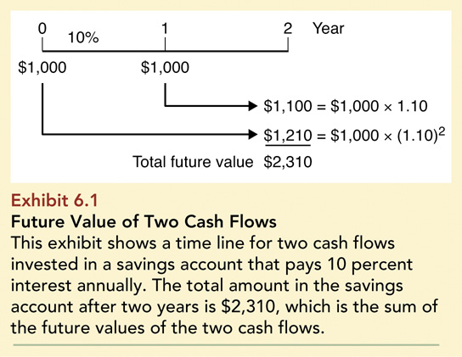
Exhibit 6.1: Future Value of Two Cash Flows

Slide 34
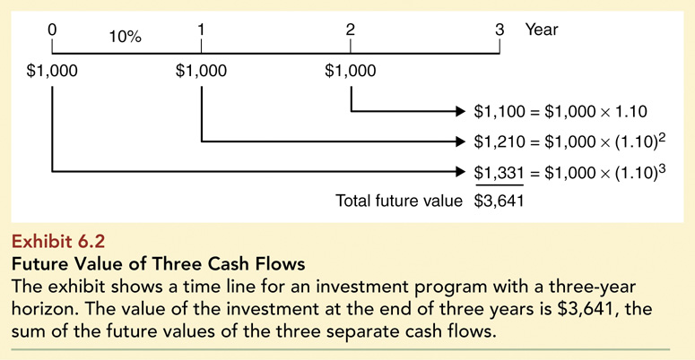
Exhibit 6.2: Future Value of Three Cash Flows

Slide 35
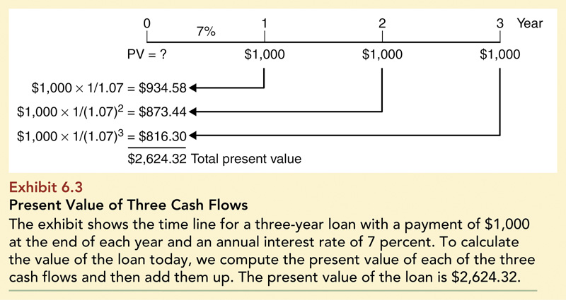
Exhibit 6.3: Present Value of Three Cash Flows

Slide 36
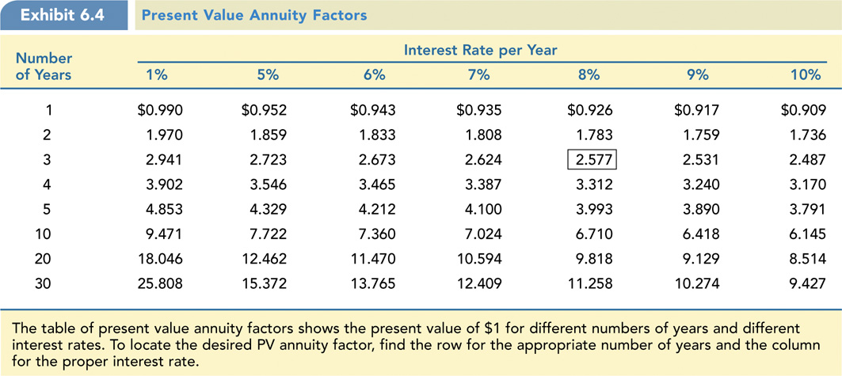
Exhibit 6.4: Present Value Annuity Factors

Slide 37
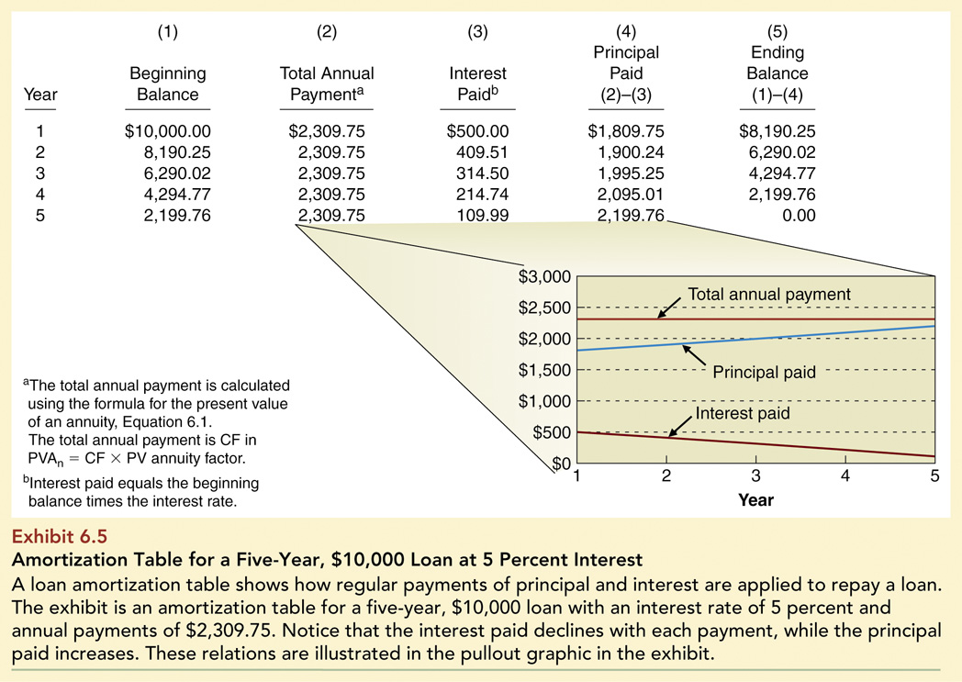
Exhibit 6.5: Amortization Table for a 5-Yr, $10K Loan

Slide 38
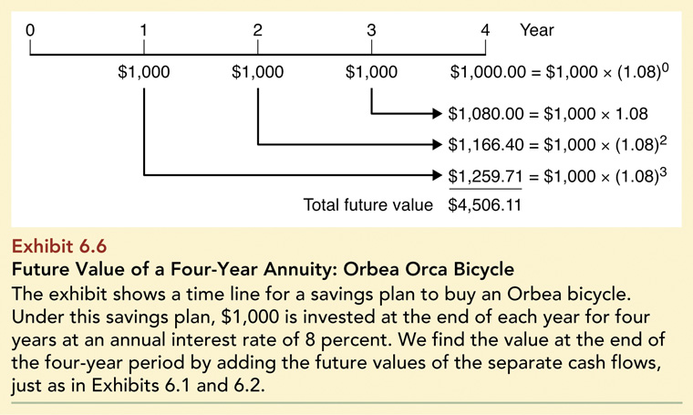
Exhibit 6.6: Future Value of 4-Yr Annuity

Slide 39
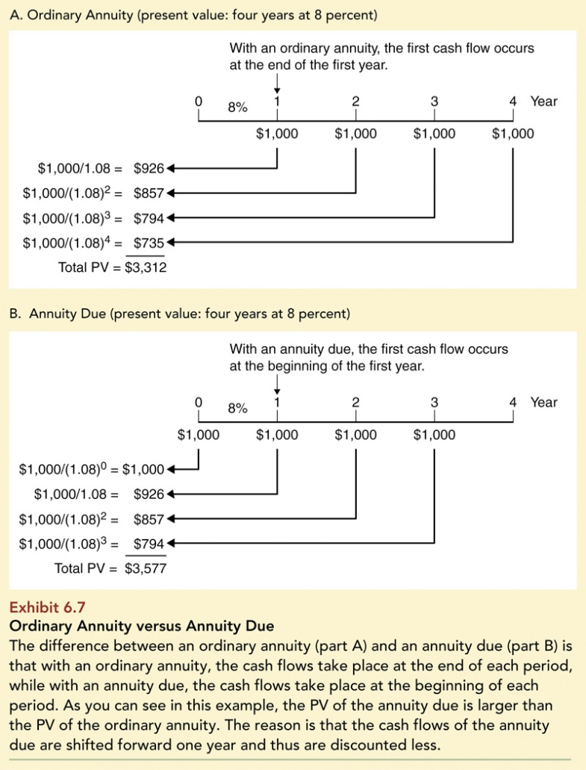
Exhibit 6.7: Ordinary Annuity versus Annuity Due

